Slide 1
Owhiro Bay Bus Network Public Meeting
By Better Buses Owhiro Bay

Slide 2
Introduction and Welcome
Notes:
This should include:
Health and Safety info for the venue (i.e Emergency exits, toilets, etc.)
Thanks to OBS for hosting
Short Introduction of Jack and Arunan
Acknowledgement of Candidates
Acknowledgement of Residents who have shown up

Slide 3
Agenda
Who We Are — Why Are We Doing This?
The Big Issues — Some of Our Findings
Story Sharing From Locals — Why This Matters
What Can be Done About it? — Our Recommendations
Conclusion — Where to from here?

Slide 4
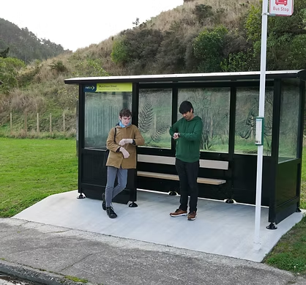
Who We Are — Why Are We Doing This?
We’re locals, having lived here almost all our lives
We’ve been using the local bus network since 2015
Always noticed we seem to be on the short end of the stick for bus quality

Slide 5
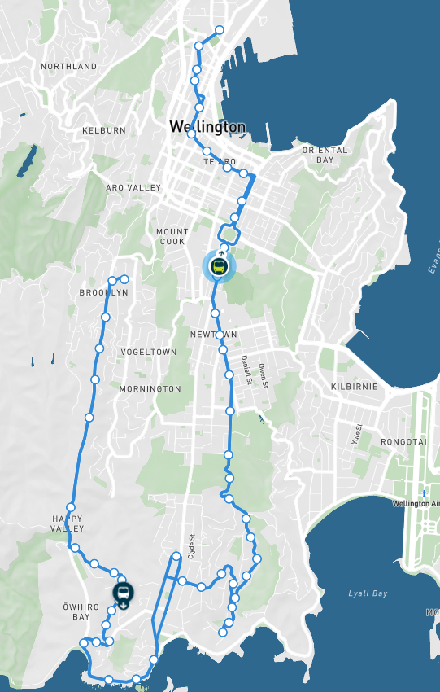
Issue 1: Do We Receive Enough Buses?
Metlink distributes buses by demand, accounting for suburb demographics
This model is not publicly available
We decided to try reverse-engineer their model
Notes:
Let’s phrase this first issue in the form of a question that we asked ourselves at the beginning of our investigation: Do we receive enough buses? Just a heads up, this is by far the most complex issue we’ll cover tonight, so please bear with me. Most of this section covers our methodology, which we’d like to discuss as a matter of transparency, and in hopes that the evidence we present becomes even more confronting.
To answer this question, we need to know how Metlink, the bus company run by the Regional Council, distributes their bus services. Once we know this, we can find out if we see an amount that should be expected, based on the criteria that they themselves consider.
Fortunately, Metlink are up front about this, and they tell us that they do this in the form of a model, which takes into account numerous factors about the suburbs within the city, and then allocates bus services where the demand makes sense to do so. Unfortunately, however, Metlink don’t tell us any more than this, as they retain their model quite closely, and don’t allow outsiders, such as ourselves, to take a look at it. This means that we have to make it ourselves, based on what they tell us about it

Slide 6
What Do You Need to Do This?
Identify comparable suburbs:
Similar population size ( ~1,000 - ~3,000 people )
Similar distance from the central city ( ~7 to ~10 km )
Similar topography ( combination of hilly and flat )
Importance as a connection road ( relatively minor )
Notes:
So, what do we need to do this? Our first step comes from identifying suburbs that are similar to our own, based on the criteria we know Metlink consider. These include the population of the suburb, where Ōwhiro Bay is just over 2,000; distance from the central city, where Ōwhiro Bay is about 8 or 9 kilometres, depending on where you start counting from; among other considerations such as topography, and our suburb’s importance as a connection road.
This last criteria is one you can think of as one of the differences between us and neighbouring Island Bay, where we’re both the same distance from the city, but people are much more likely to connect through Island Bay as opposed to Ōwhiro Bay to get to the south coast, as they’re a more important thoroughfare than ourselves.

Slide 7
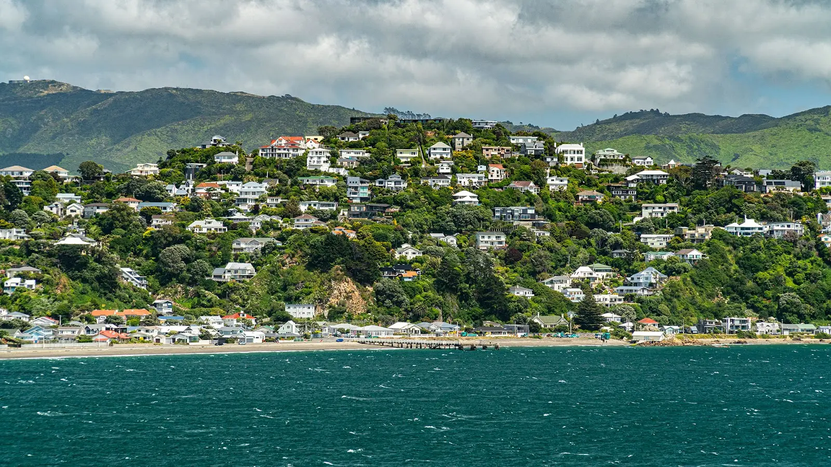
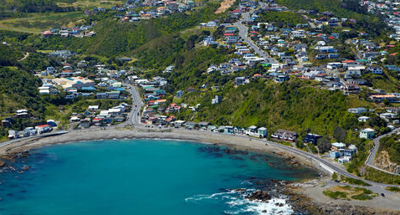
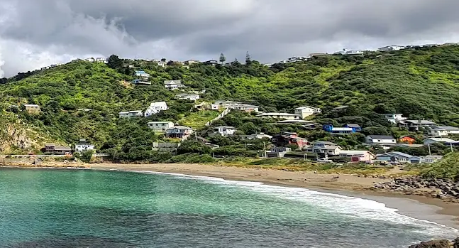
Suburb Comparison
 | Seatoun | Ōwhiro Bay | Houghton Bay
Population | 2,350 | 2,050 | 1,700
Distance from City | ~ 9.5 km | ~ 8 km | ~ 8.5 km
Topography | Combination of steep hills and flats | Combination of steep hills and flats | Combination of steep hills and flats
Other Comparable Suburbs We Identified: Karaka Bays, Maupuia, Melrose, Southgate
Notes:
From this point, we can make tables much like these ones that compare us with other suburbs. In this example, whether you’d like to believe it or not, suburbs like Seatoun and Houghton Bay share many criteria in common with us, to the point that Metlink would look at them and consider us similar enough to them that the same model of distributing bus services should be used.
What you’ll notice is that the suburbs we found to be comparable to Ōwhiro Bay, including the ones listed at the bottom here, typically have a lot in common with the suburbs along our city’s south and east — so that being similar distance from the city, populations of about 1 to 3 thousand, and usually along the coast but with significant hills, among numerous other things.

Slide 8
Model Building — Final Step
How do we make a model from this?
Find out how many buses each suburb gets (per hour, on average)
Quantify demand
Graph them — plot one against the other
Notes:
Our last step is to take this information to make our model. To do this we need to know how many buses each of these suburbs receive, and then how we can quantify demand. For the first point, this can be found by scraping the Metlink website, so no trouble there, but our second point needs us to get slightly more creative.
In this case, we took information from the NZTA Waka Kotahi that established in a large report they put out that the rates of demand for public transport across the southern and eastern suburbs, the ones we care about, are directly intertwined with the population of those suburbs.
Essentially what this means is we can model demand simply by using the population of these suburbs, where bigger suburbs should see more buses and smaller suburbs should see fewer. With this all said and done, should we see what this model looks like?

Slide 9
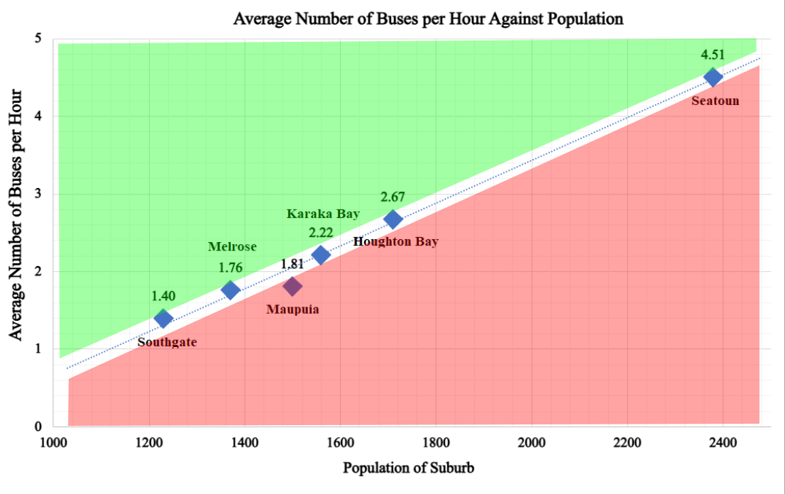
Notes:
This is shocking, and it was very alarming when we first discovered it. This model works perfectly in replicating the distribution of buses across our city, with the one and only exception being Ōwhiro Bay [Next Slide].

Slide 10
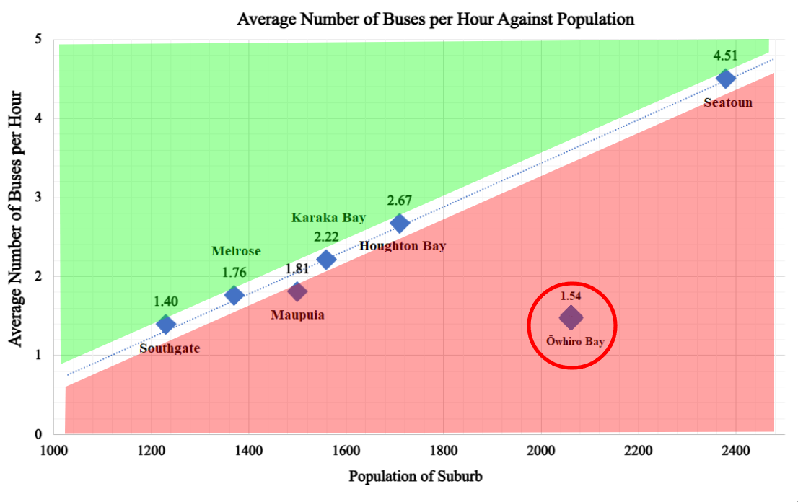
57% Deficit
Notes:
The number of buses we see, 1.54 an hour for every direction, or one bus every 38 minutes on average, is what you should expect to see in a suburb less than half our size. If we were to see an equitable level of service given our findings, we should see a bus about once every 18 minutes on average. This represents a deficit in the number of buses we see of more than 55%. So, to answer our original question: do we receive enough buses? Given the evidence we put forward, we would answer: decidedly not.

Slide 11
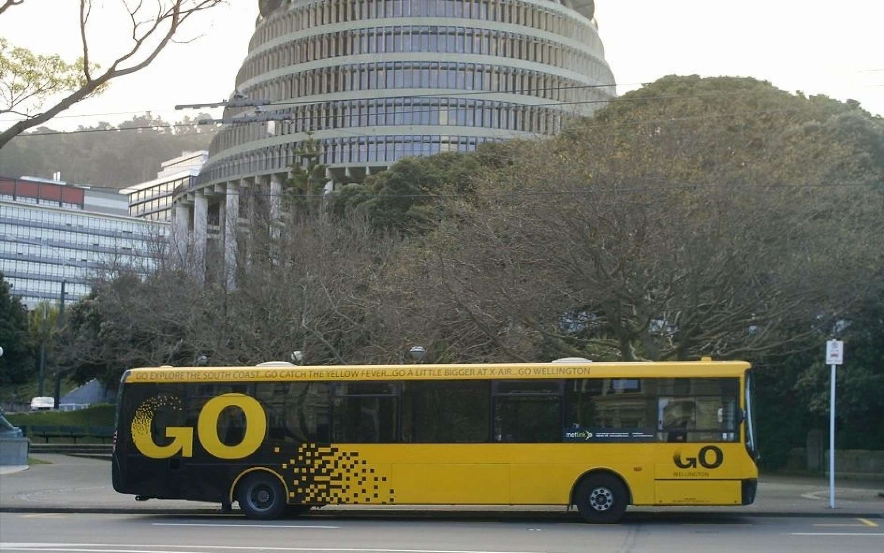
Issue 2: Ōwhiro Bay’s On-peak Network
Used to be served by the former Route 4
13 services a day between Ōwhiro Bay and Molesworth Street
7am - 8.30am ; 3.30pm - 6.30pm
10 - 25 minute frequency
35 minute journey from start - end
Notes:
The next issue we identified was the state of the on-peak Owhiro Bay Network
Many of us will mainly use just the on-peak network, that is the Route 39 to get to and from work. However, the state of our on-peak services is actually significantly worse than it used to be
What I’ll run you through is a comparison between the current on-peak network today, and what it looked like 7-8 years ago
Prior to mid-2018, there was the old Route 4, and it went to Ōwhiro Bay.
More than a dozen services a day, over pretty decent hours of service, and on exceptional frequency — once every 10 minutes during peak rush hour and about 20 to 25 minutes during the slower parts of the on-peak
The Route 4 was replaced with the 29e in 2018, which in 2020 was replaced by the Route 39, which is currently the only on-peak service that is available to us
We bring up the Route 4 because, compared to what we have now, our Route 39 appears sorely lacking in what it could have been

Slide 12
Comparison — Old vs. New
 | [Former] Route 4 | Route 39
Number of Services per Day | 13 | 8
Hours of Service per Day | 4.5 | 3
Frequency | 10 - 25 minutes | 30 minutes
Journey Time (Wellington Station - 4 Happy Valley Rd) | 35 minutes | 32 minutes
Notes:
Here we have a straight comparison between the two, with the Old Route 4 on the left and the Route 39 on the right
As you can see, the services we see in Ōwhiro Bay have gone considerably backwards.
This is already pretty bad, but what we learnt was that during the 2018 changes, many suburbs actually saw improved services

Slide 13
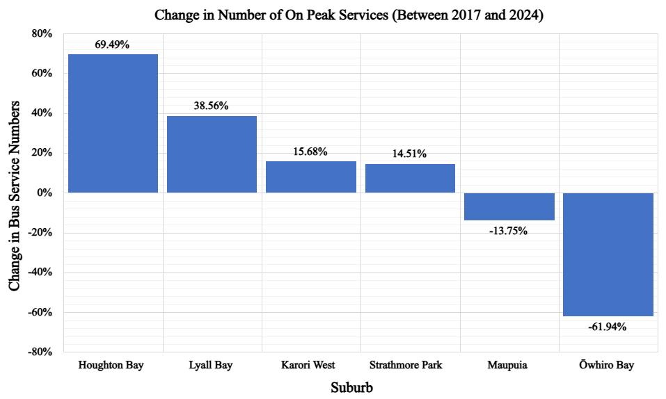
Notes:
This graph shows that between 2017 to now, suburbs like Houghton Bay and Lyall Bay have seen considerable increases in the number of services they see a day.
But Ōwhiro Bay… saw a 62% reduction in On-peak services over this time period
Maupuia was the only other suburb to see cuts to its on-peak bus numbers, but these cuts are not even remotely comparable in their severity to what Metlink did to Ōwhiro Bay with our Route 4

Slide 14
Route 39 — Worse Than You’d Think
Consistently fails to meet Metlink’s own reliability metrics for “satisfactory” performance
Frequently cancelled
Significant overcrowding issues
No longer provides on-peak connection to Newtown, Berhampore, Island Bay, etc.
Notes:
But guess what, it gets even worse:
In 2024, there was only one month where Route 39’s reliability was high enough to meet Metlink’s own standards of satisfactory performance (95% reliability)
It is one of the most cancelled services in the network. During the 2023 driver shortages, it had ~20% of all services cancelled
Its low service numbers mean that it is at much greater capacity, often overcapacity, to service even more people than the old Route 4 used to
Route 39 is the most infrequent on-peak bus service in the entire network, with one bus every half-an-hour for when it operates. The next slowest is the Moa Point Route 30x, which comes about once every 20 minutes
Finally, Route 39 is the only on-peak bus service in the entire bus network to see its last morning service finish before the school drop-off window begins, making it impossible for working parents to drop-off their children here at Ōwhiro Bay School and be able to take the bus to work in the city

Slide 15
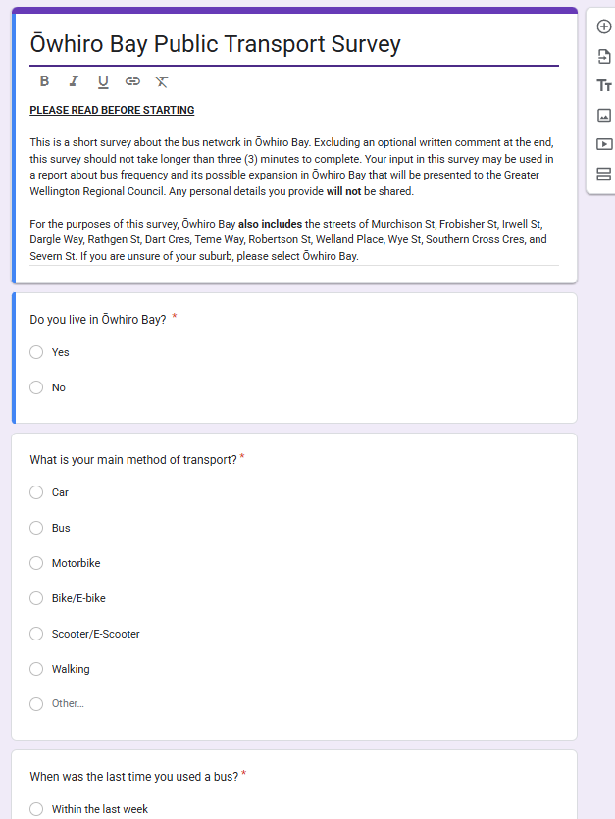
Issue 3: How We Interact With Our Buses (Survey)
Public Survey of Residents
Available January - February 2024, both in-person and digitally
We surveyed more than 200 people in Ōwhiro Bay
Largest survey ever to take place in our suburb
Notes:
We received feedback from people of incredibly varied backgrounds, and because of our very significant sample size, we feel confident in saying the results we obtained are highly relevant and indicative in explaining how we as a community use and feel about our local bus network

Slide 16
Noteworthy Findings
38% of residents use buses as their main form of transport — Southern Suburbs average is 25%
70% of residents use the bus at least once weekly — 40% use five days per week or more
40% of residents say non-Ōwhiro Bay buses (e.g. 1, 32x) comprise their main routes
Notes:
We build on these findings because they help paint a picture about something many residents say they do frequently

Slide 17
Commuting to Other Suburbs
63% of Ōwhiro Bay residents always or often travel to neighbouring suburbs to use their bus network instead of our own
- 83% said this is because Ōwhiro Bay buses are not good enough to rely on
- Increases traffic, decreases parking spaces in Island Bay, Brooklyn, and the CBD
- Lowers patronage on Ōwhiro Bay bus services

Slide 18
Dissatisfaction With Ōwhiro Bay Bus Network
Average satisfaction rating between 0 - 10 of local bus network among residents is 2.7 / 10
- Regional averages over last five years are 6.5 - 6.9 / 10
- Only 7% of residents are satisfied — 80% regionally
- 84% are dissatisfied — 11% regionally
- 28% extremely dissatisfied — 1% regionally
- 14% of residents don’t believe our bus network can get any worse than it already is
Notes:
We asked residents to rate their satisfaction with the local bus network on a scale of 0 to 10, with 0 being “it couldn’t get worse”, 5 being neither satisfied nor dissatisfied, and 10 being “it’s perfect”.
In fact, the next most dissatisfied demographic in the entire region according to Metlink this year comes from users of the Wairarapa Train Line which is about 40%, which is only half as much as the average Ōwhiro Bay resident
With this all said and done, we’d like everyone to pat themselves on the back for getting through the densest part of the evening as now we’d like to move on to our next section, which is the sharing of stories from members of the community

Slide 19
Residents’ Testimony
Notes:
Stories and Testimony from Resident’s highlighted the need for more bus services in our suburb

Slide 20
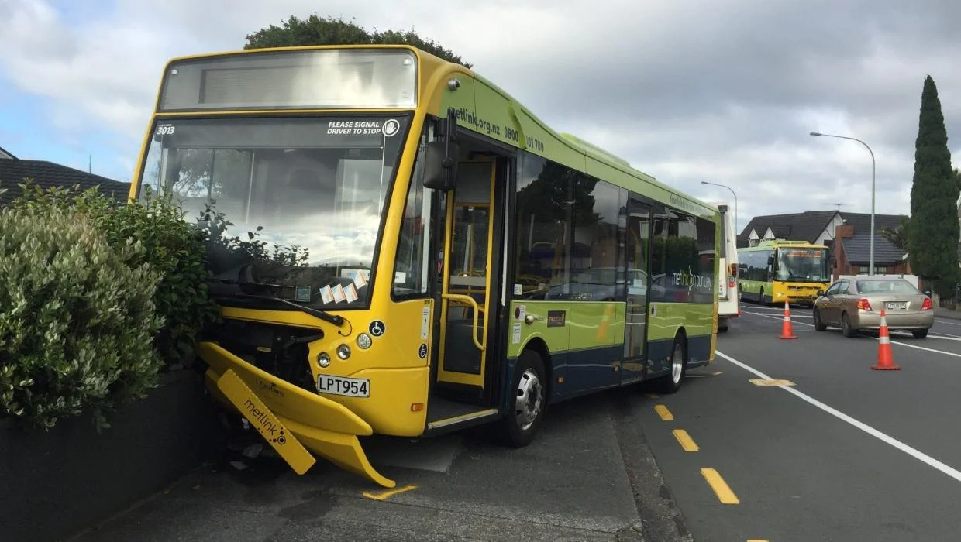
How Do We Fix This?
Notes:
You’ve now heard both the numbers and the experiences of locals that tell you that we’ve got some pretty bad bus services in our suburb
But it doesn’t have to be like this. There are many simple solutions to the issues we face. Today we’ll be present three that we have identified

Slide 21
Three Main Recommendations*:
Route 1 Extension
More Frequent Route 39s
Route 29 Extension from Brooklyn to Wgtn Station
*These are not the only solutions. In our report, we included five more recommendations.
Notes:
These three recommendations are ones that we believe will have a significant impact on the bus service levels in our suburb

Slide 22
Other Possible Solutions
NEW Route Brooklyn-Kilbirnie Route (via Ōwhiro Bay)
Addresses gap in network
Consistent Route 29 timetable
Provides better off-peak service
Light Rail in Wellington City (Railway Station-Southern Suburbs)
Redistribution of Public Transport Resources
Notes:
Here are other possible solutions that could also help, and have been discussed amongst the community
Our discussion will mainly be focused on the initial three:
Route 1 Extension
More Frequent Route 39s
Route 29 Loop Service

Slide 23
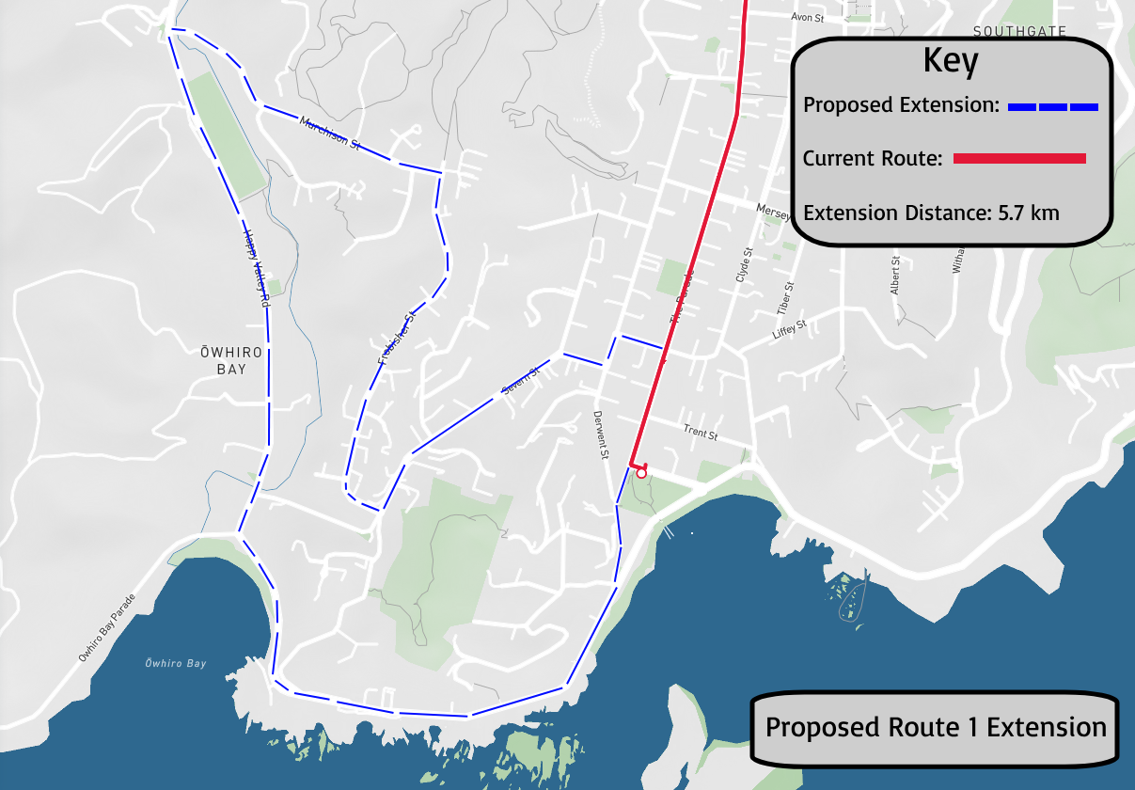
Recommendation 1: Route 1 Extension
Route 1 is a core route
- Major transport spine, high frequency
Would be same path as former Route 4
- service to Happy Valley Rd, Severn St
Comparable extension to Route 2 in Seatoun
- Occur every 2nd or 3rd service
Notes:
Route extension is in Blue on the map
Would follow the current route used by the School Buses (+ old Route 4)
Service would finally be re-established for Happy Valley Road and Severn Street

Slide 24
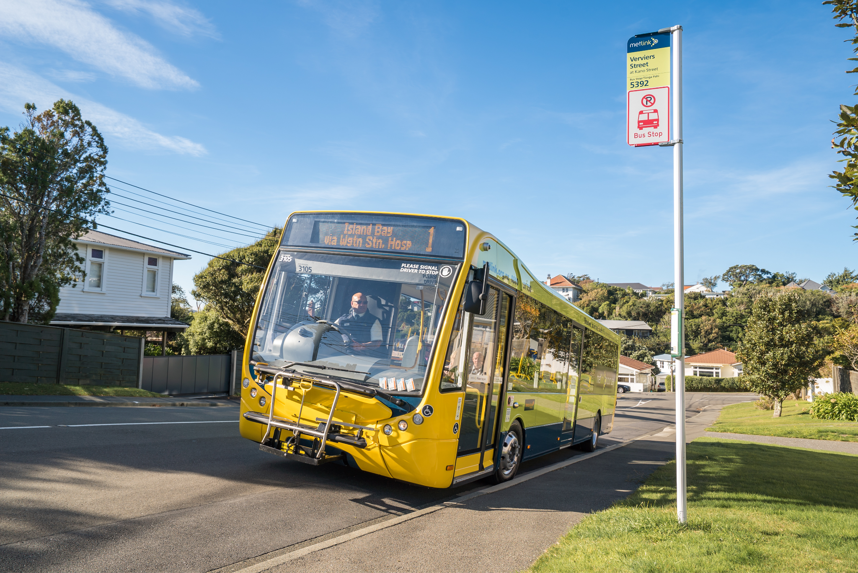
Route 1 Extension — Achievability
More than 80% support from residents
Has been previously investigated and costed by Metlink
Abundant infrastructure and evidence of workability
Further support from future southern bus depot
Notes:
More than 80% of residents said they would support such an extension, with 87% saying they would likely use it if it existed
From the survey, we learned that the loss of services to areas such as Happy Valley Road and Severn St was detrimental to many’s usage of public transport overall, and that bringing back a bus route for these people can make the difference
This is a complicated area to travel without a vehicle, given with our considerably steep hills. Many physically can't travel through the suburb on foot, but this is currently what all the school bus services do, so we know it is possible for buses to run here
This extension, therefore, solves all of these issues
Metlink has already investigated this extension in the past, so we know how much it would cost them, but also we know that there aren’t any outstanding barriers to enacting this extension. For example, Metlink understands that our roads aren’t too steep or too damaged or too narrow, which would otherwise make such a change challenging
The bus stops are already in place from where the Route 4 used to go, which are just waiting to be used again, including a few like the one outside of the school here that has a shelter, but is never used otherwise.
Finally, with the creation of the bus depot on landfill Rd, which we know is controversial, Metlink will really have little excuse not to implement the extension. With buses from Island Bay travelling through Ōwhiro Bay, it will be hard not to justify increasing service levels to our suburb

Slide 25
Recommendation 2: Increased Route 39 Frequency
Proposal: Increase the number of services for Route 39
Result:
Increase service levels back to that seen pre-2018
Better represents the actual demand for Route 39
Lessened impact of any future cancellations and suspensions
Notes:
We know Route 39 is incredibly popular. The majority of commutes happen during peak hours, and for Ōwhiro Bay residents, that means Route 39. From our survey, we know that the overwhelming perspective of 39 commuters is that there simply aren't enough of them and their timetables are far too narrow to be workable for many, and we know the numbers show this to be true. Our initiative is to increase their numbers.

Slide 26
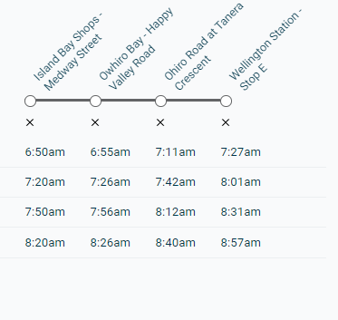
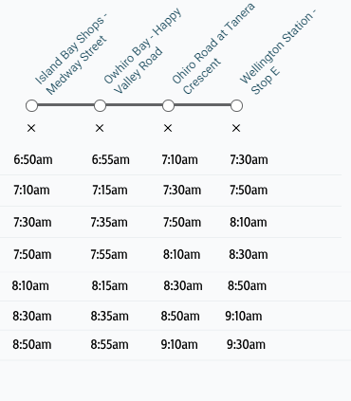
Current Improved
Proposed Timetable:
*Evening peak times would receive similar increases
Notes:
This would mean that Ōwhiro Bay wouldn’t see the slowest on-peak network in the city, but rather would be much closer to the city-wide average. Also, working parents would have ample time and opportunities to drop off their children here at school and still take the bus to work in the city. And this exemplar would hold for the evenings too, with more services outright, as well as services that go later into the evening hours

Slide 27
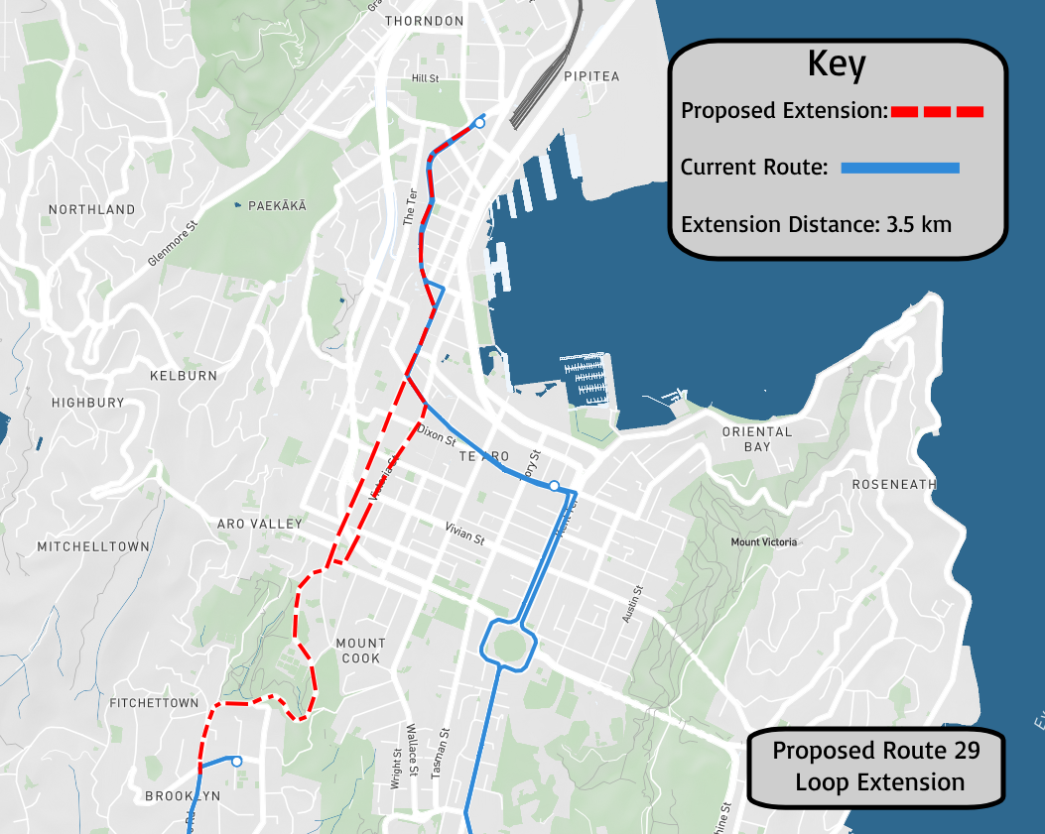
Recommendation 3: Route 29 Loop Extension
Popular initiative among residents
Not necessary to connect at Brooklyn to gain access to CBD
Direct route to CBD during off-peak hours, including weekends
Timelier than current Route 29 options
Notes:
One of the major things we learnt from our survey, and something many people have told us throughout all of this, was the desire for the creation of a “39 on the weekends”. That is, a direct service to the central city during the off-peak.
Currently, the 29 serves that purpose, but it means we need to either rely on Route 7 and 17, or take the scenic route through Southgate and Newtown to get there. Either way, it's often an hour-long trip to get anywhere on the weekends
What we're proposing is an extension of Route 29, from the Brooklyn Library to the CBD, essentially replicating Route 39, but with a 29 extension.
Would avoid the risk of missing a transfer to a Route 7 or 17 service
Would provide the quick CBD connection that is needed off-peak
It could also be the case that this extension could pay for itself by lessening the burden of Brooklyn's routes 7 and 17, meaning there could be reductions in their numbers, as this would provide a third option for commutes from the CBD to the Brooklyn shops

Slide 28
What’s Next?
Local govt elections upcoming (9 Sep–11 Oct)
Sign our petition (if you haven’t already)
Presenting petition to newly elected regional council
2nd Survey in January 2026
Continued advocacy
Talk to your neighbours about this issue!
Notes:
That’s all the information we had for you today!
What’s Next for us?
Local Government Voting is open
Sign our petition on our website – we’ll be presenting it to the newly elected regional council
We will be doing a second survey in January 2026

Slide 29
Concluding Thoughts
Ōwhiro Bay bus services are quite bad, but they can be better
People of all walks of life across our community are affected by our poor bus services
Sign our petition to support our recommendations
Voting for local elections has already started! Remember to vote between now and 11 October

Slide 30
Thanks for Coming!

Slide 31
References and Image Credits
Greater Wellington Regional Council. (2011). Wellington Transport Models. (https://www.gw.govt.nz/assets/Documents/2022/03/TN0C3079-Model-Investigation-Report.pdf).
Metlink. (2022). Public Transport Passenger Satisfaction Survey. (https://www.metlink.org.nz/assets/Customer-Satisfaction-Surveys/GWRC-Public-Transport-Customer-Satisfaction-Survey-June-2022_Public-Report_2.pdf).
Metlink. (2023). Public Transport Passenger Satisfaction Survey June 2023. (https://www.metlink.org.nz/assets/Customer-Satisfaction-Surveys/GWRC-Public-Transport
Customer-Satisfaction-Survey-June-2023-PUBLIC.pdf).
Waka Kotahi NZ Transport Agency. (2020). Regional mode shift plan – Wellington. (https://www.nzta.govt.nz/assets/resources/keeping-cities-moving/Wellington-regional-mode-shift-plans.pdf).
Stepan Ozhigov. (n.d.). (https://sandee.com/new-zealand/wellington/wellington/seatoun-wharf).
David Wall. (2014). (https://www.alamyimages.fr/photo-image-owhiro-bay-wellington-ile-du-nord-nouvelle-zelande-vue-aerienne-79612156.html)
Tim Noble. (n.d.). (https://sandee.com/new-zealand/wellington/houghton-bay).
The Raroan. (c. 2017). (https://hail.to/rroa-normal-intermediate/article/gr6Rdt9).
Matthew Tso. (2019). (https://www.stuff.co.nz/dominion-post/news/110350416/bus-into-lower-hutt-fence).
Full list of references found pp. 73 - 76 of our full report

